Slide 1
Confidence Intervals, Effect Size and Power
Chapter 8

Slide 2
The Dangers of NHST
We already discussed that statistically significant does not always mean practically important
Be especially skeptical if they have very large sample sizes (without any of the information presented in this chapter)

Slide 3
Example of Practical Importance: Seatbelts
Seatbelts haven’t been shown to be statistically significant at saving lives
Why?
Because we don’t want to have enough people die to show that it’s significant
Very practically useful however
Notes:
Need new example here

Slide 4
Practically Useful Numbers
So how do we judge a study for practical significance?
Confidence Intervals (small = good)
Effect size (big = good)

Slide 5
Confidence Intervals
Point estimate: summary statistic; one number as an estimate of the population
e.g., mean
Just one number rather than an aggregate…

Slide 6
Confidence Intervals
Interval estimate: based on our sample statistic, range of sample statistics we would expect if we repeatedly sampled from the same population
e.g., confidence interval (CI)
Tells you a lot at once!

Slide 7
Confidence Intervals
Interval estimate that includes the mean we would expect for the sample statistic a certain percentage of the time were we to sample from the same population repeatedly
Typically set at 95% or 99%
Notes:
Hint: that matches p < .05, p < .01

Slide 8
Confidence Intervals
The range around the mean when we add and subtract a margin of error
Confirms findings of hypothesis testing and adds more detail

Slide 9
Confidence Intervals
Maybe a solution to the problems of NHST?
Some argue we should calculate means and CIs and if they do not overlap, that means they are different!
Only works sometimes though…

Slide 10
Confidence Intervals
The calculations are not that different than what we’ve been doing:
Take a z-score where 95% of the data is in the middle of the distribution
Translate that back to a raw score to match the mean
(draw)

Slide 11
Calculating Confidence Intervals
Step 1: Draw a picture of a distribution that will include confidence intervals (CIs)
Step 2: Indicate the bounds of the CI on the drawing
Step 3: Determine the z statistics that fall at each line marking the middle 95%
Step 4: Turn the z statistic back into raw means
Step 5: Check that the CIs make sense

Slide 12
Confidence Interval for z-test
M_{lower} = -z(σ_{M}) + M_{sample}
M_{upper} = z(σ_{M}) + M_{sample}
Think about it: Why do we need two calculations?

Slide 13
Example
Let’s compare the average calories consumed by patrons of Starbucks that posted calories on their menus to the population mean number of calories consumed by patrons of Starbucks that do not post calories on their menus (Bollinger, Leslie, & Sorensen, 2010).
The population mean was 247 calories, and we considered 201 to be the population standard deviation. The 1000 people in the sample consumed a mean of 232 calories.

Slide 14
Think About It
Which do you think more accurately represents the data: point estimate or interval estimate?
Why?
What are the advantages and disadvantages of each method?

Slide 15
Effect Size: Just How Big Is the Difference?
Significant = Big?
Significant = Different?
Increasing sample size will make us more likely to find a statistically significant effect

Slide 16
Effect Size: Just How Big Is the Difference?
 | Small Effect Size | Big Effect Size
Fail to reject null | Probably not there, sample size not issue | Important! May not have enough people in study (Type II error)
Reject null | Probably not there, sample size may be causing rejection (Type I) | Important and we found it! (power)

Slide 17
What is effect size?
Size of a difference that is unaffected by sample size
How much two populations do not overlap
Standardization across studies

Slide 18
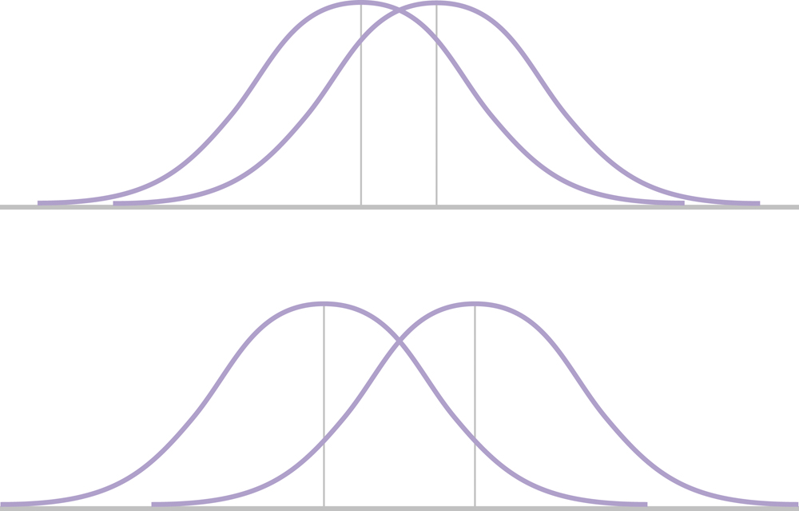
Effect Size & Mean Differences
Imagine both represent significant effects
Which effect is bigger?

Slide 19
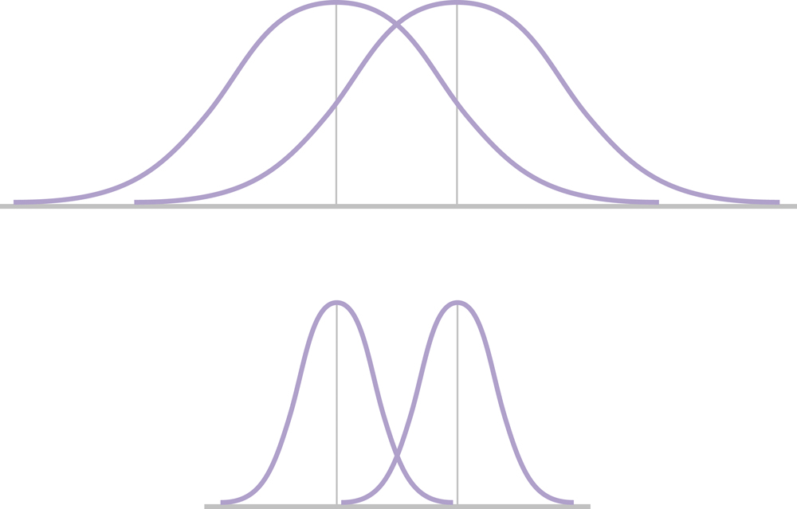
Effect Size & Standard Deviation
Note the spread in the two figures
Which effect size is bigger?

Slide 20
Increasing Effect Size
Decrease the amount of overlap between two distributions:
1. Larger difference between means = larger effect
The average scores of the populations are further apart
See slide 18
2. Smaller standard deviations = larger effect
The variation within each population is smaller
See slide 19

Slide 21
Calculating Effect Size
Cohen’s d estimates effect size
Assesses difference between means using standard deviation instead of standard error

Slide 22
Example
Let’s compare the average calories consumed by patrons of Starbucks that posted calories on their menus to the population mean number of calories consumed by patrons of Starbucks that do not post calories on their menus (Bollinger, Leslie, & Sorensen, 2010).
The population mean was 247 calories, and we considered 201 to be the population standard deviation. The 1000 people in the sample consumed a mean of 232 calories.

Slide 23
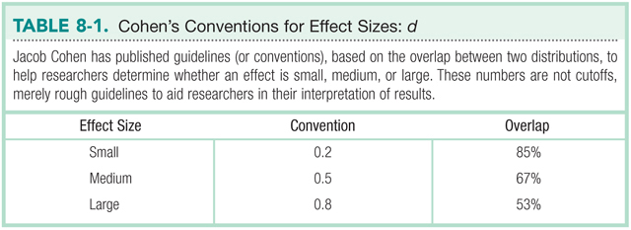

Slide 24
Statistical Power
The measure of our ability to reject the null hypothesis, given that the null is false
The probability that we will reject the null when we should
The probability that we will avoid a Type II error

Slide 25
Power Rangers Example
See handout!

Slide 26
Calculating Power
Step 1: Determine the information needed to calculate power
Population mean (μ_{M})
Standard error (N, σ_{needed})
Sample mean found (M)

Slide 27
Calculating Power
Step 2: Determine a critical z value (cut off score)
Calculate raw score for that z:
M_{needed} = μ_{M} + (σ_{M}) * z

Slide 28
Calculating Power
Step 3: Figure out the distance between the M needed and sample M you estimated
z = (M_{needed} – M_{sample}) / σ_{M}
Then the percentage of the distribution above/below that score is power
(matches your hypothesis of higher or lower)

Slide 29
What increases power?

Slide 30
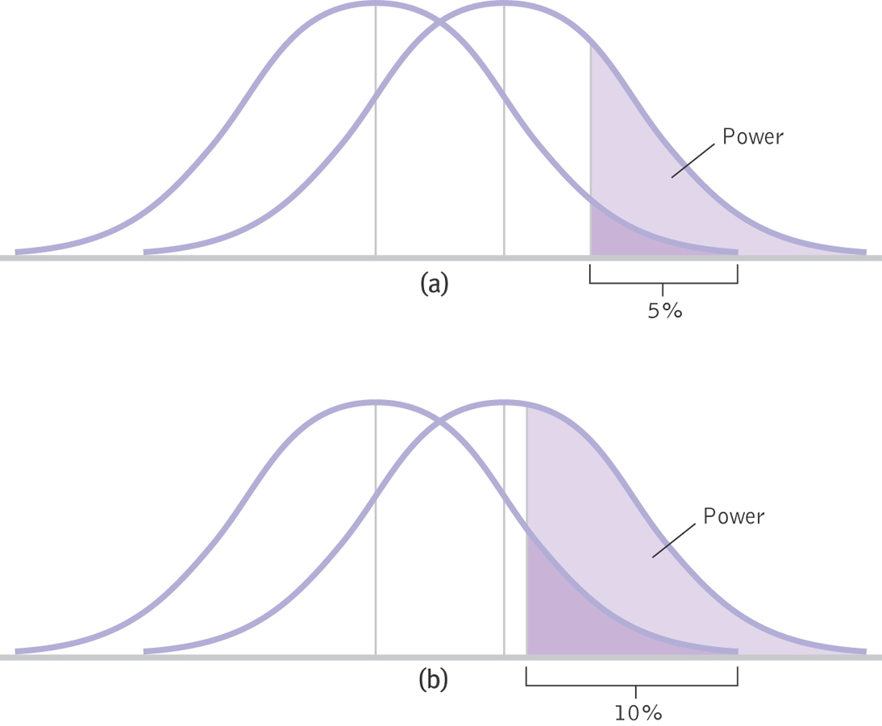
Increasing Alpha

Slide 31
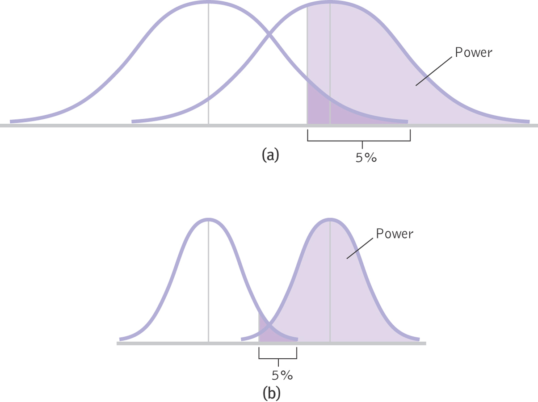
Two-Tailed Verses One-Tailed Tests

Slide 32
Increasing Sample Size or Decreasing Standard Deviation
Notes:
Both of these decrease standard error

Slide 33
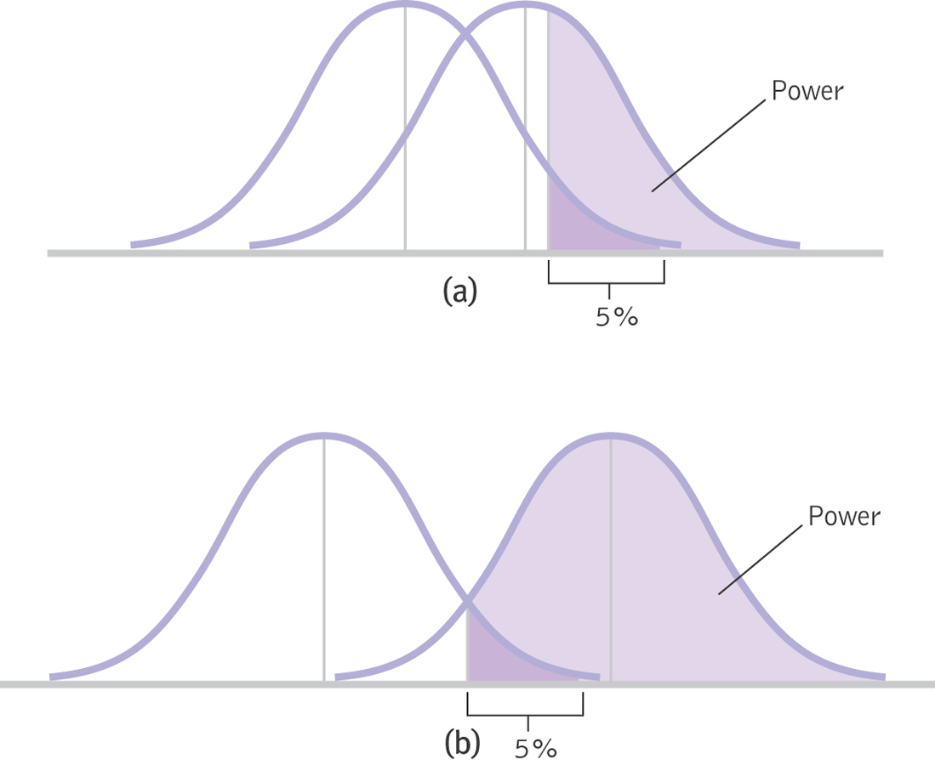
Increasing the Difference between the Means
Notes:
Effect Size

Slide 34
Factors Affecting Power
Sample size
Higher sample size increases power
Alpha level
Higher alpha level increases power (e.g., from .05 to .10)
One- or two-tailed?
One-tailed tests have more power than two-tailed tests
Standard deviation
Small standard deviation = more power
Difference between the means
Large difference between means = more power

Slide 35
Think About It
Why would it be important to know the statistical power of your study?

Slide 36
Meta-Analysis
Meta-analysis considers many studies simultaneously
Allows us to think of each individual study as just one data point in a larger study

Slide 37
The Logic of Meta-Analysis
STEP 1: Select the topic of interest
STEP 2: Locate every study that has been conducted and meets the criteria
STEP 3: Calculate an effect size, often Cohen’s d, for every study
STEP 4: Calculate statistics and create appropriate graphs

Slide 38
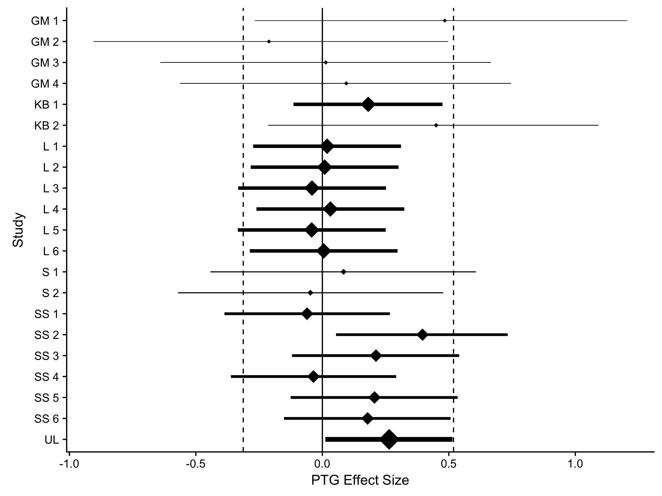
Notes:
Effect sizes for different studies on post traumatic growth due to expressive writing; since they are all really close to zero, probably not much of an effect

